Slide 1
“Game of Life”
Andrew & Grehg

Slide 2
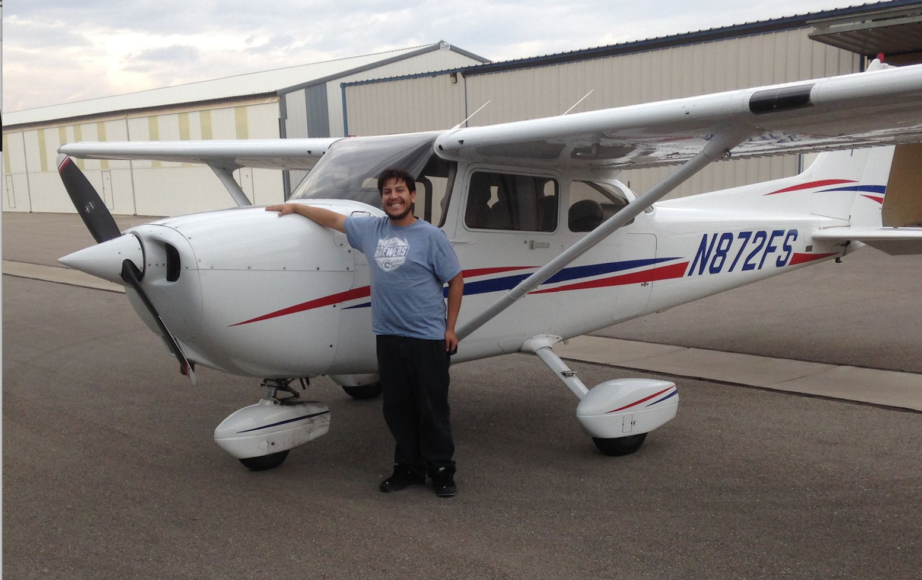
Andrew Koprowski

Slide 3

Grehg Hilston

Slide 4



Slide 5
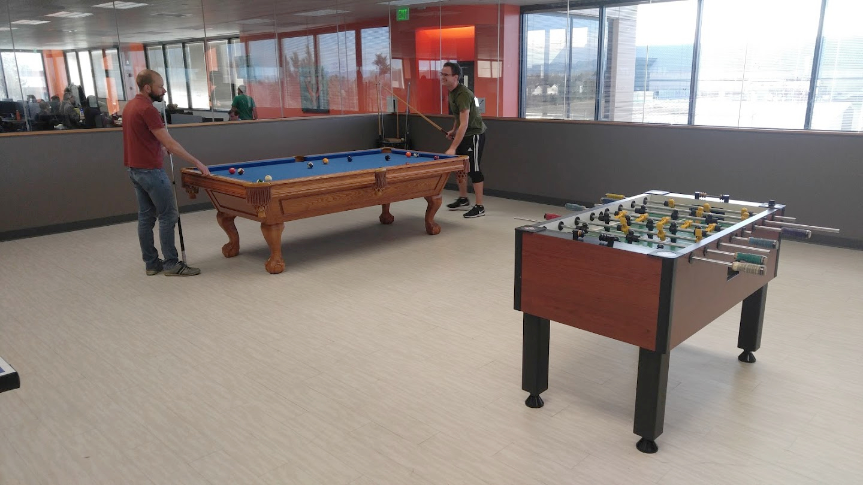

Slide 6
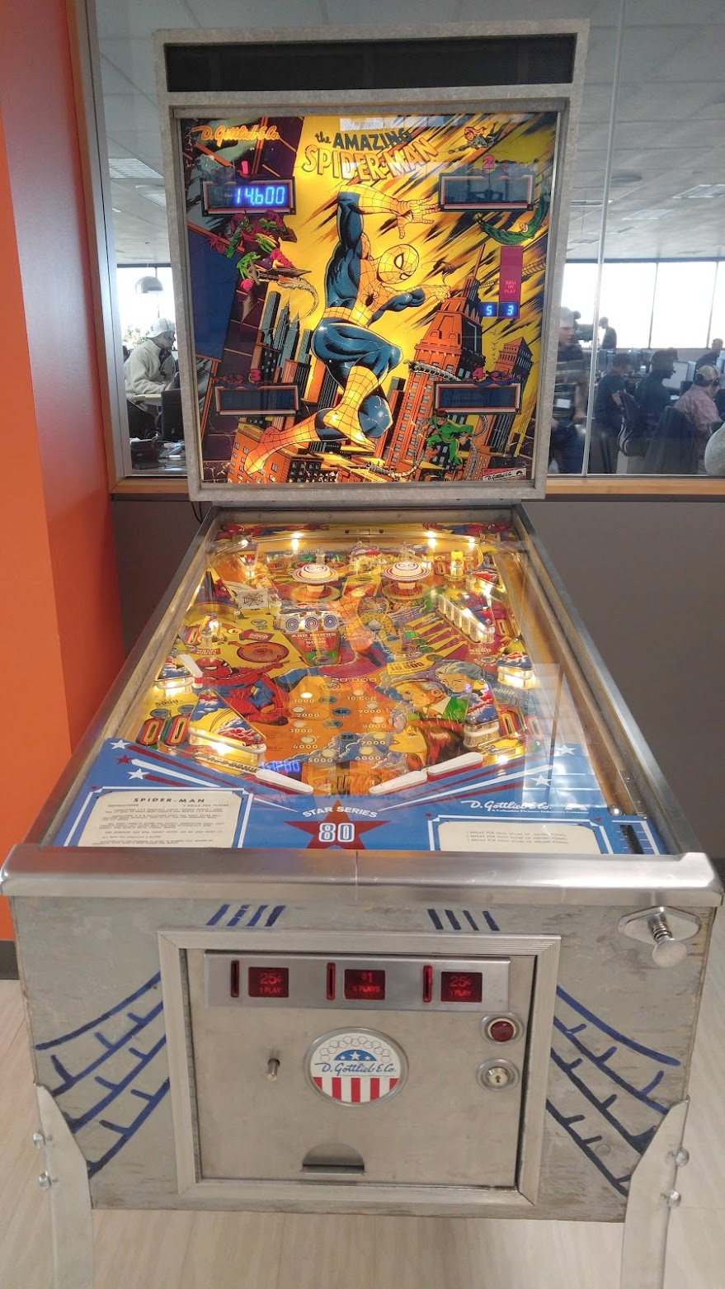
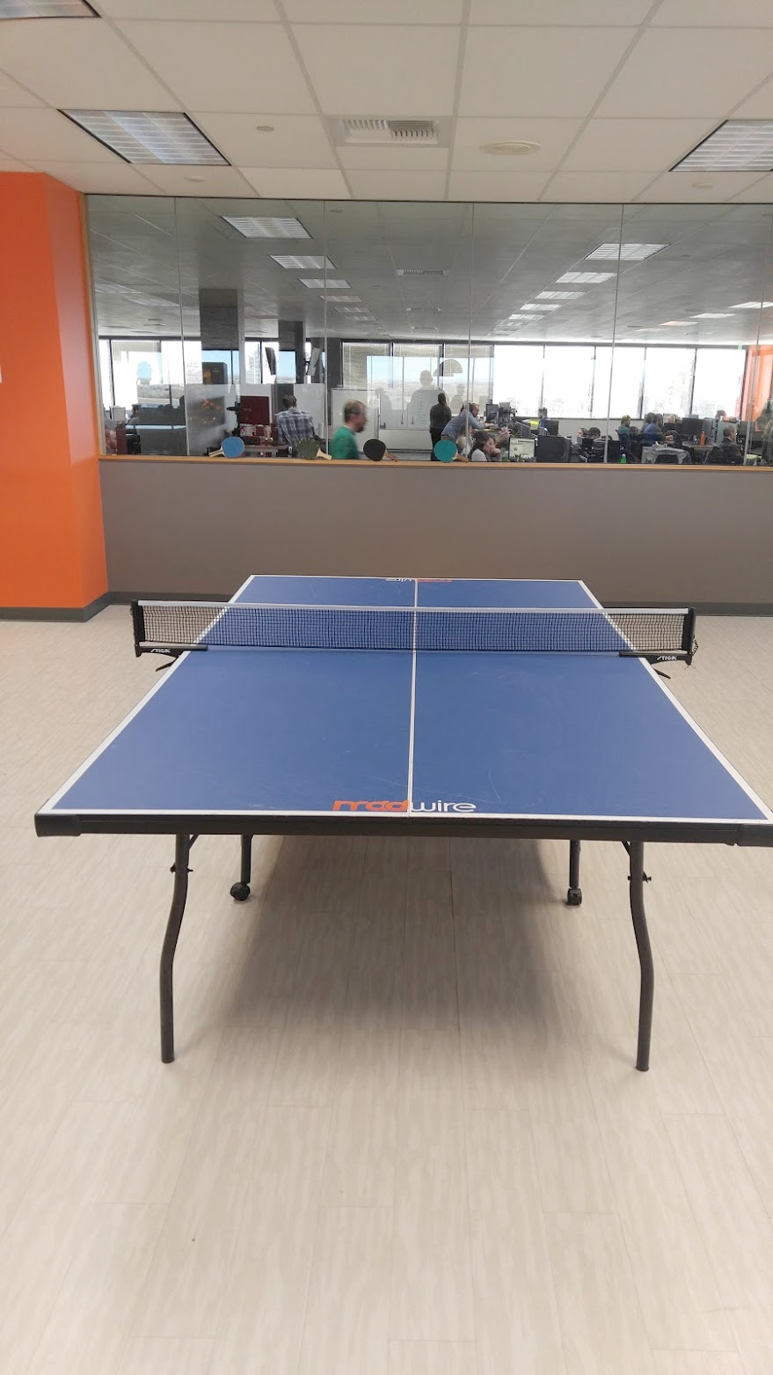
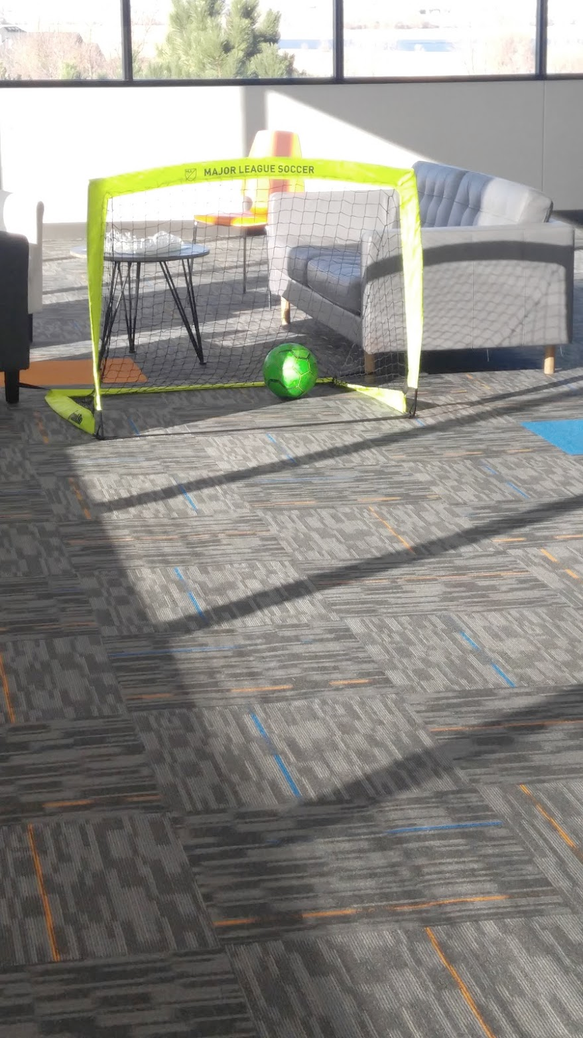

Slide 7
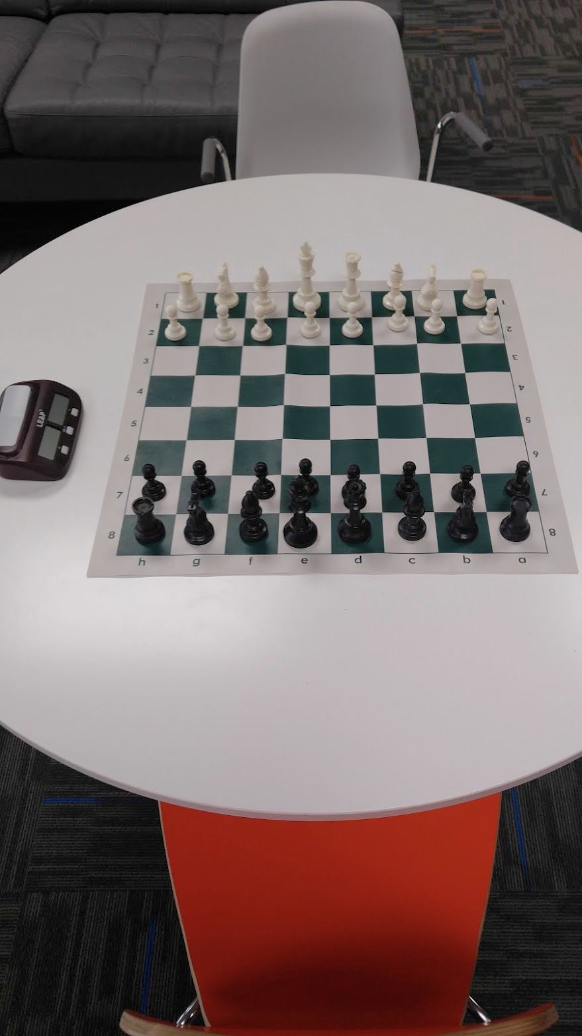
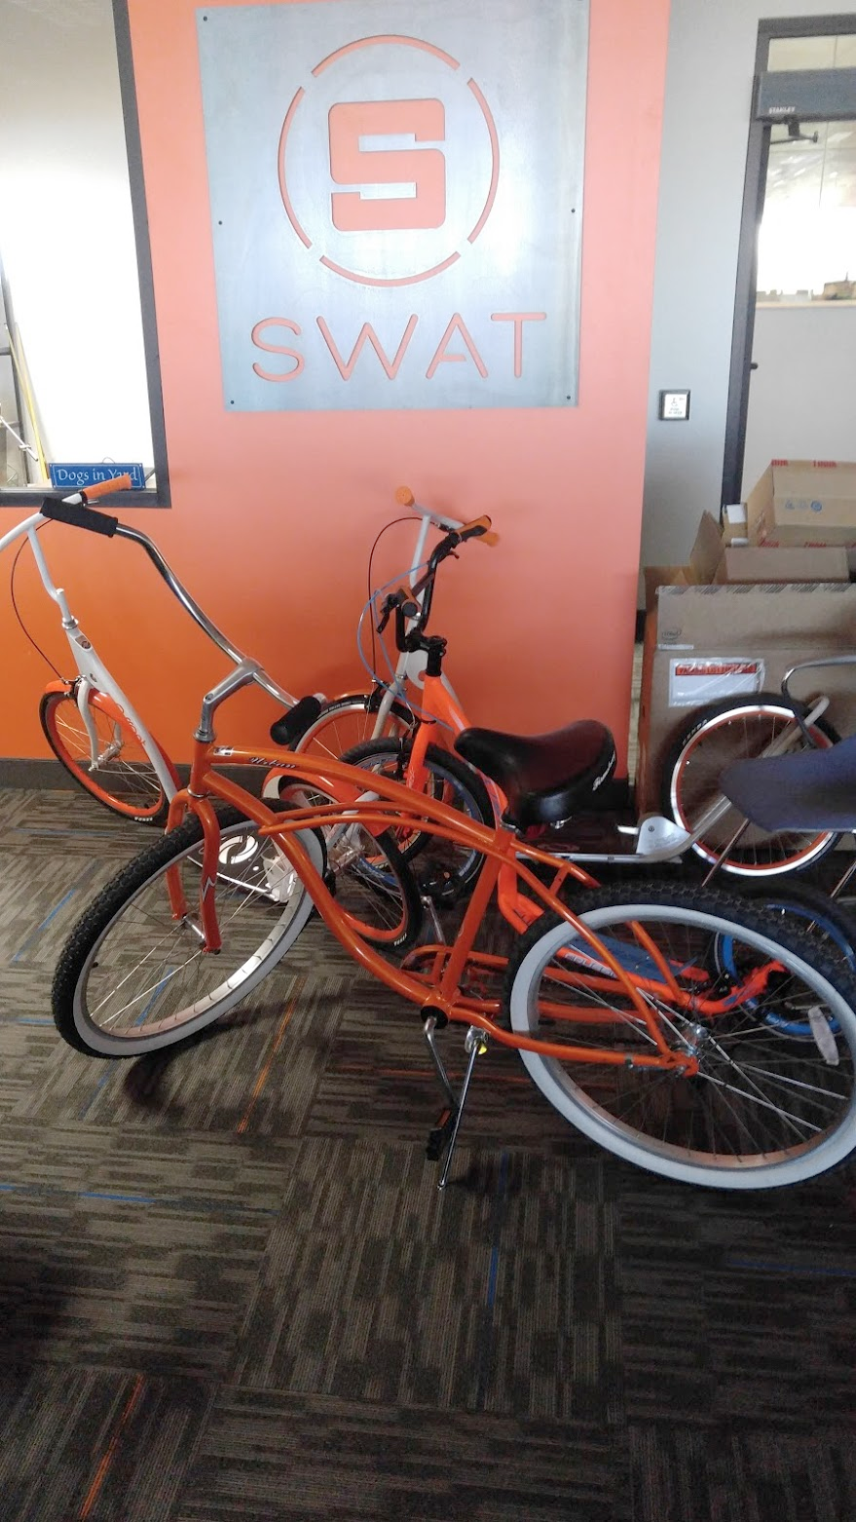
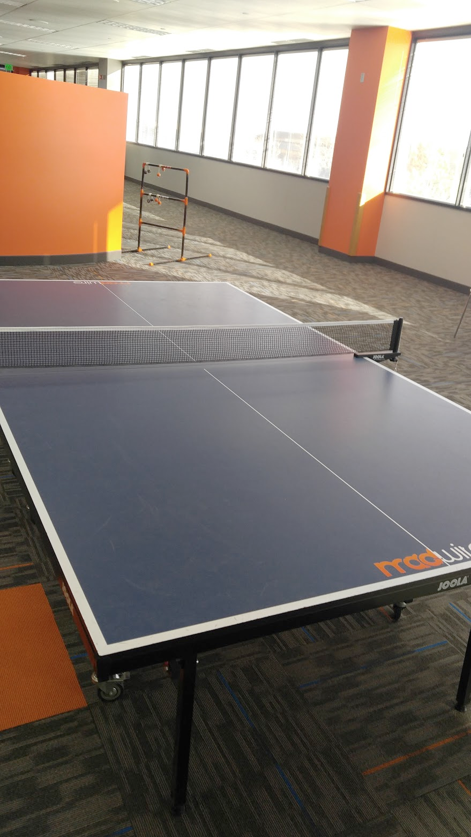

Slide 8


Slide 9

Mobile Team
Notes:
Discussion Questions:
Who has written software before?
What languages have you used or heard of?
Does anyone here plan on studying software engineering or computer science?
How many have Android?
How many have an Apple device?

Slide 10
Game of Life
goo.gl/eZhkwp
Break off into groups, spend ten minutes playing with the games and try to answer the following questions:
What does this represent?
How does it work?
What patterns did you notice?
If you find something cool, click “Export” and “Link” and save the link so we can explore it.

Slide 11

Game of Life
a cellular automata
Created by John Conway in 1970, a British mathematician
Turing complete

Slide 12
Rules
Rules:
Underpopulation:
Any live cell with fewer than two live neighbours dies
Survival:
Any live cell with two or three live neighbours lives
Overpopulation:
Any live cell with more than three live neighbours dies
Reproduction:
Any dead cell with exactly three live neighbours becomes a live cell

Slide 13
Live Demo
Lets implement:
Number of live neighbors
Underpopulation rule
Survival rule
Reproduction rule
Overpopulation rule
Notes:
We’ll do this in my Playground’s code and then Kprow’s

Slide 14

Still Life - Block
Example

Slide 15
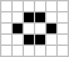
Still Life - Beehive
Example

Slide 16

Still Life - Loaf
Example

Slide 17

Still Life - Boat
Example

Slide 18

Still Life - Tub
Example

Slide 19

Oscillators - Blinker (period 2)
Example

Slide 20
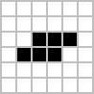
Oscillators - Toad (period 2)
Example

Slide 21

Oscillators - Beacon (period 2)
Example

Slide 22
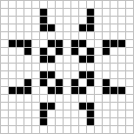
Oscillators - Pulsar (period 3)
Example

Slide 23

Oscillators - Pentadecathlon (period 15)
Example

Slide 24

Spaceships - Glider
Example

Slide 25

Spaceships - Lightweight Spaceship
Example

Slide 26

Spaceships - New Spaceship
Example

Slide 27
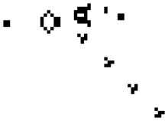
Cool Scene - Glider Gun
Example

Slide 28
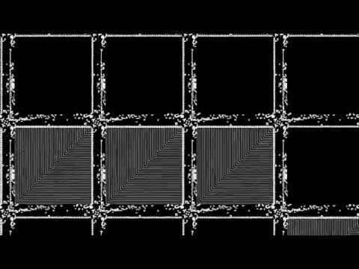
Life in Life

Slide 29
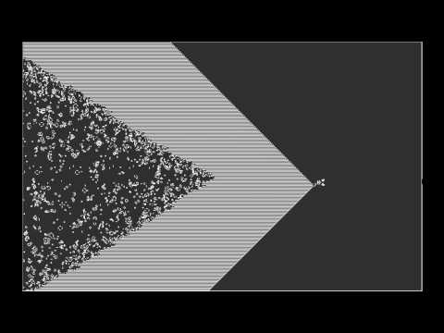
Epic Conway’s Game of Life
Notes:
Start at 1:10

Slide 30
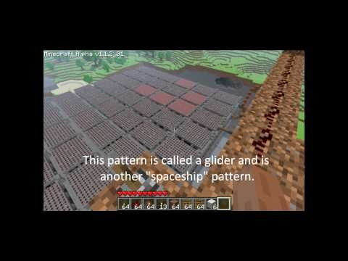
Game of Life In Minecraft
Notes:
Start at 1:10

Slide 31
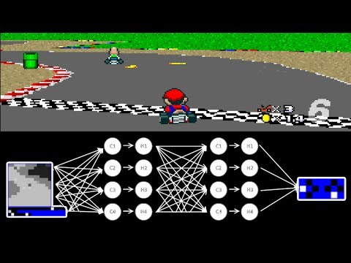
MariFlow - Self-Driving Mario Kart

Slide 32
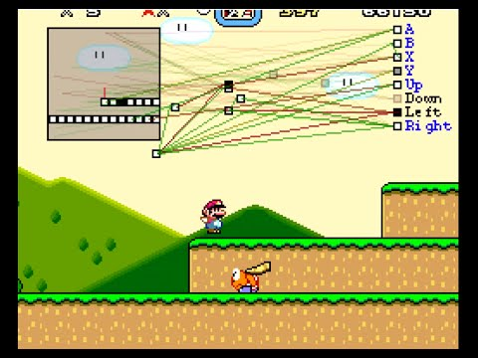
MarI/O - Machine Learning for Video Games

Slide 33
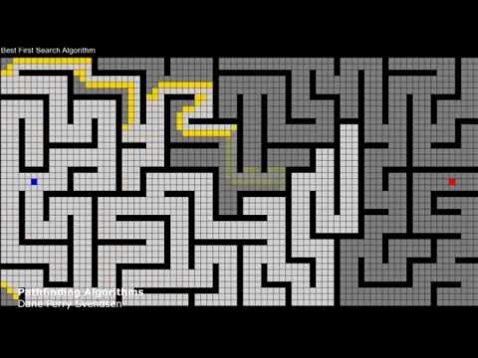
Pathfinding Algorithms

Slide 34
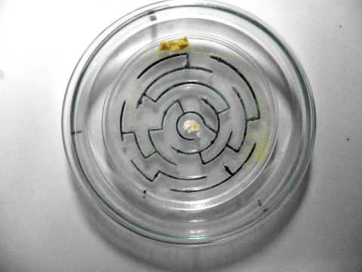
Slime Mold Pathfinding

Slide 35
Programming Usages
Video game development
Virtual reality
Augmented reality
Home automation
Minecraft redstone
Pretty much every industry uses software
Computer graphics and animation
Avionics
Internet connected devices (internet of things)

